Slide 1
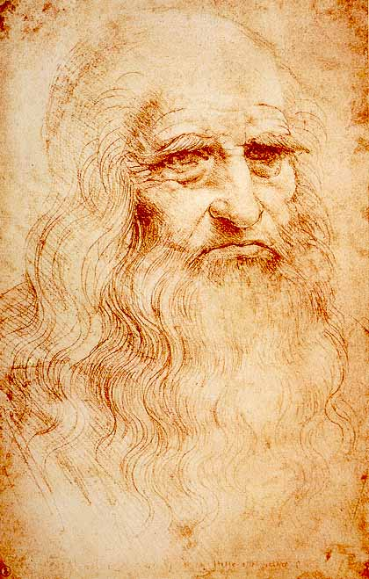
My mom always says ,,Practice make perfect’’.
Practice make perfect.
Praktyka czyni mistrza.

Slide 2
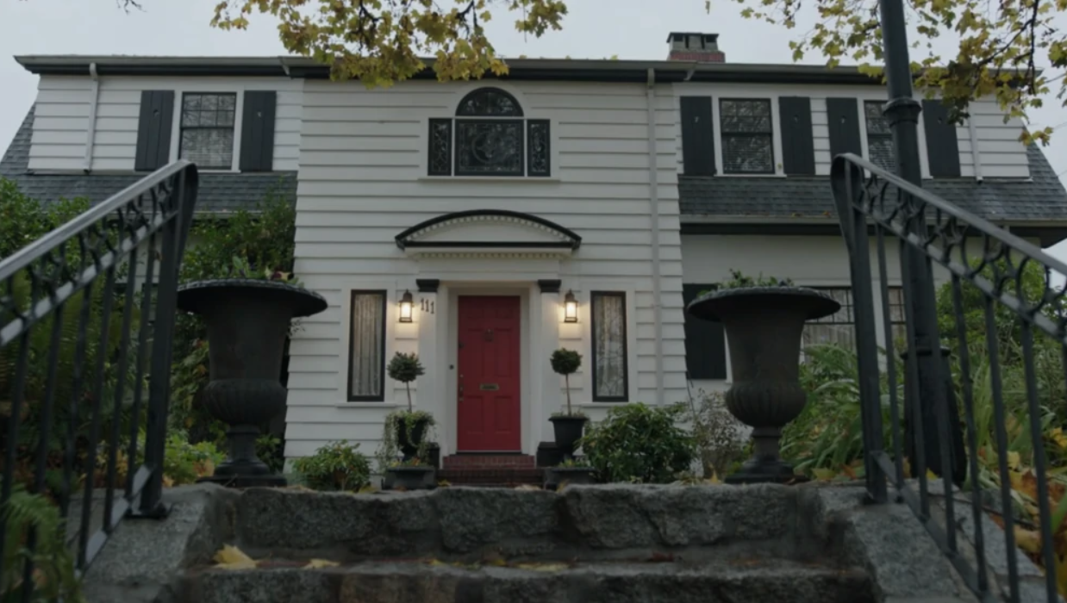
Everywhere is good but home is best. Wszędzie dobrze ale w domu najlepiej.
After returning home, my dad says "everywhere is good but home is best„.

Slide 3
Friends are knwon in proverty. Przyjaciół poznaje się w biedzie.
For the rest of my life I will remember that "Friends are known in poverty„.

Slide 4
Better late than ever. Lepiej późno niż wcale.
Better late than never to make wishes.

Slide 5
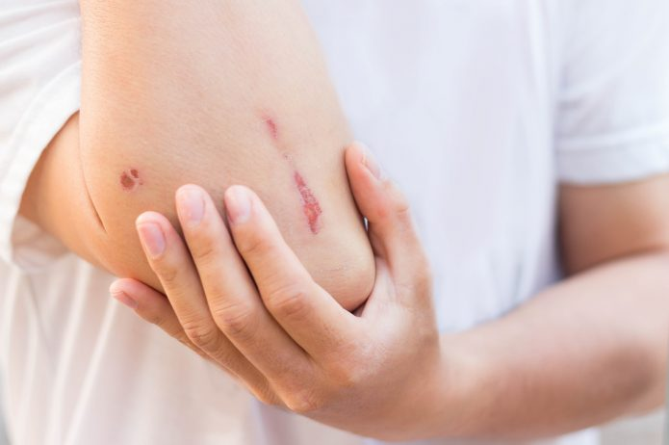
It will heal by the wedding. Do wesela się zagoi.
My grandmother always says ,,It will heal by the wedding’’.

Slide 6
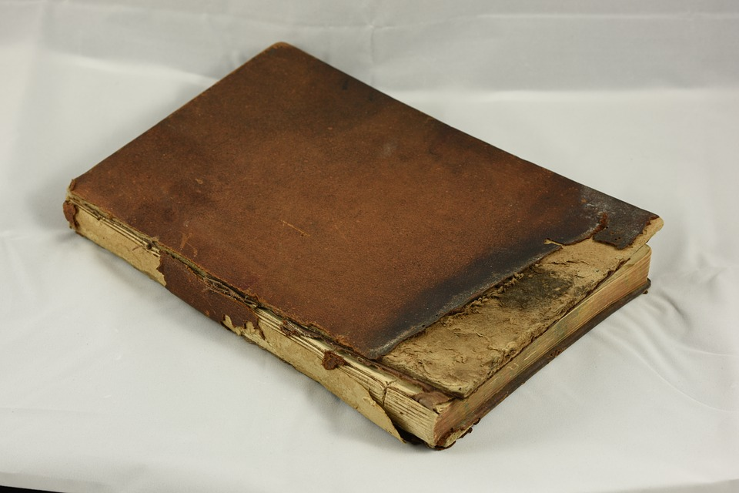
Never judge a book by its cover. Nigdy nie oceniaj książki po okładce.
I am taught not to judge a book by its cover.

Slide 7
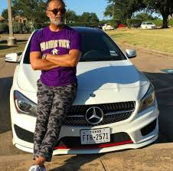
A man is as old as he feels. Człowiek ma tyle lat, na ile się czuje.
From my grandfather, I can see that a man is as old as he feels.

Slide 8
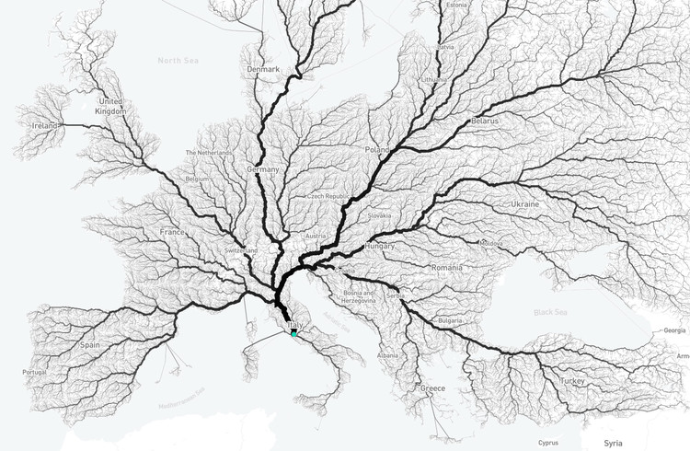
All roads lead to Rome. Wszystkie drogi prowadzą do Rzymu.
Apparently, all roads lead to Rome.

Slide 9
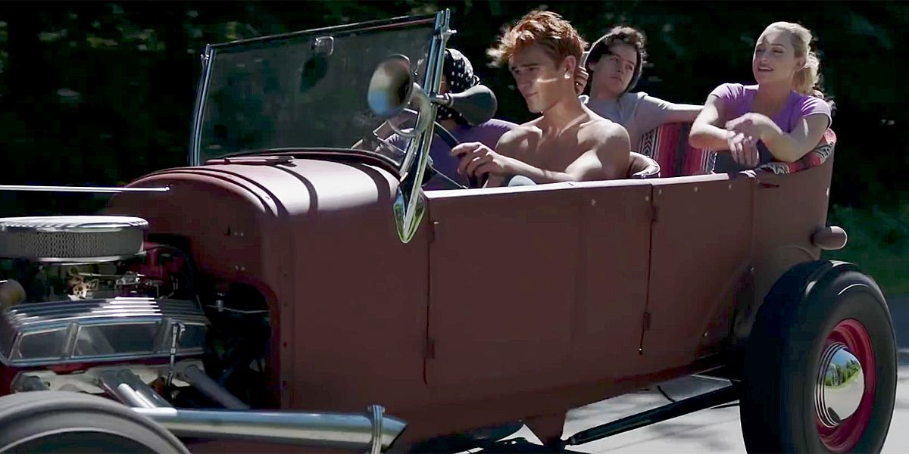
Let’s have marvelous adventures together. Przeżyjemy razem cudowne przygody
My sister and her friends had wonderful adventures together.

Slide 10
Dziękuję za uwagę
Autor: Urszula Chodnicka

